Slide 1

Material For students to start the work

Slide 2
Maze Generation
Task
Generate and show a maze, using the simple Depth-first search algorithm. Start at a random cell. Mark the current cell as visited, and get a list of its neighbours. For each neighbour, starting with a randomly selected neighbour: If that neighbour hasn't been visited, remove the wall between this cell and that neighbour, and then recurse with that neighbour as the current cell.
Coding Challenge #10.1: Maze Generator with p5.js - Part 1
https://www.youtube.com/watch?v=HyK_Q5rrcr4

Slide 3
Reference Book
A must reference book for those who prepare
For programming competitions

Slide 4
What is a Maze?
A maze is a complex structure of interconnected passageways. There should be (at least) one way to get from a designated start location to a designated end. Typically the path is convoluted and branched (these branches can also be branched, and often leading to dead-ends) making it not obvious to the naked eye the correct path to take (even when exposed to a God’s eye view from above with all information exposed).
Mazes are even more challenging to solve when you are inside one and are only exposed to the information you can immediately see!

Slide 5
These days, maze is not only used as a puzzle but also adopted in many different fields.
In the field of computer games, it can be used as a basic structure for a 'game level'
In the field of robotics, it can be used as a platform to demonstrate the robot's learning ability.
Also, in the field of architecture, its pattern can be used to decorate a building

Slide 6
Perfect maze is one type of a maze that has neither loops nor inaccessible areas.
A perfect maze has a structure of a spanning tree, spanning tree generation algorithms, such as Prims algorithm and Kruskals algorithm, can be used.
Spanning tree is a graph where all nodes of the graph are connected by its edges without any loops
A regular grid is a grid which consists of rectangle cells

Slide 7
Representation of a grid graph on 4x4 regular grid. Each node of the grid graph is denoted by circle, and each edge of the grid graph is denoted by purple edge.
b) An example of a spanning tree in a 4x4 grid. It consists of subset of edges of the grid graph in (a).
On a regular grid, a perfect maze can be generated from a spanning tree.
When a spanning tree is generated on a regular grid, the perfect maze is created by choosing any two nodes of the spanning tree for the start point and the end point of the maze as represented
Perfect maze generated from the spanning tree in Figure 3b with the start (blue point) and the end (red point).

Slide 8
Remove the wall where ever
Spanning tree crosses walls
of original square grid
A perfect maze built based on a spanning tree in a 3x3 grid. (b) Walls are placed on the perfect maze. (c) Game level generated from the perfect maze.

Slide 9
Generating Mazes-Recursive Backtracker
Different algorithms for generating mazes work in different ways. Some start with a ‘solid’ block and ‘carve’ out passages as they progress. Others start with an ‘empty’ space and ‘build’ walls. The back track recursive algorithm is a carving algorithm: It starts out as a complete grid with all boundaries and walls set and removes walls to generate the labyrinth.
Here we are using a 2D rectangular grid but the technique can be generalized to any tessellating shapes in any number of dimensions.

Slide 10
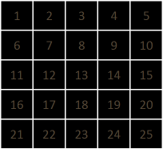
Recursive Backtracker
We'll demonstrate this with a small (5x5) maze.
The cells are numbered as seen on the left. RED squares are cells that have been visited. The stack is currently empty. All the walls are are currently present between all locations in the grid.
https://datagenetics.com/blog/november22015/index.html

Slide 11
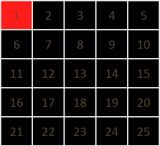
Algorithm Step by Step
1
Next we select a location to start.
This can be random, but let's chose #1.
This location is pushed onto the stack.
We've visited our first location.
STACK: 1
Watch the breaking of the wall
as the algorithm proceeds

Slide 12
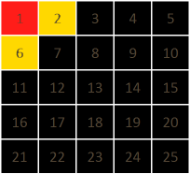
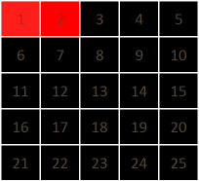
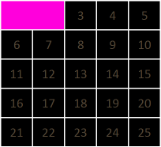
2
We're currently at grid location #1.
Next we enumerate all possible destinations from here.
We find out all possible (non-visited) locations that are adjacent to the current location. We'll show these in YELLOW
The possible locations are #2 and #6.
We'll select one of these at random.
Wall between cells 1 and 2
Is broken
3
We've selected #2.
This location is now pushed onto the stack. We now carve a path between #1 and #2.
We do this by removing the wall seperating these two locations. The image on the right shows the maze as it is developing. The Magenta locations have been visited.
STACK: 1 2

Slide 13
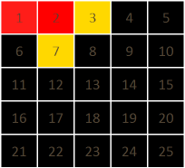
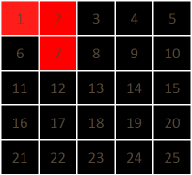
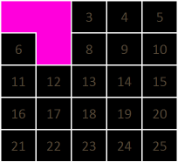
We again enumerate the possible next locations. Again, there are two to select from: #3 and #7.
STACK: 1 2
4
Wall between cells 2 and 7
Is broken
5
We've selected #7.
This location is now pushed onto the stack.
We now carve a path between #2 and #7.
STACK: 1 2 7

Slide 14
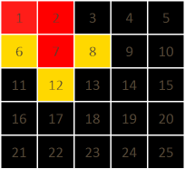
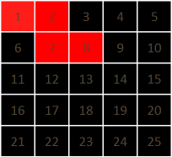
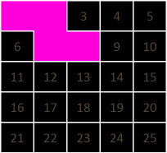
This time there are three possible next locations: #6, #8 and #12.
STACK: 1 2 7
6
Wall between cells 7 and 8
Is broken
7
We've selected #8.
This location is now pushed onto the stack.
We now carve a path between #7 and #8.
STACK: 1 2 7 8
The maze is starting to develop!

Slide 15
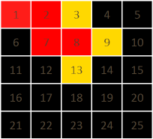
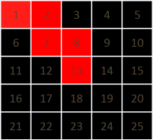
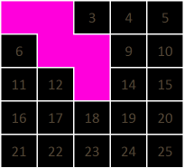
9
Again there are three possible next locations: #3, #9 and #13.
STACK: 1 2 7 8
10
Wall between cells 8 and 13
Is broken
We've selected #13.
This location is now pushed onto the stack.
We carve a path between #8 and #13.
STACK: 1 2 7 8 13

Slide 16
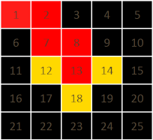
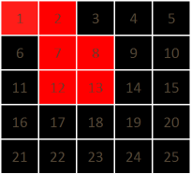
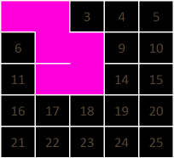
Again there are three possible next locations: #12, #14 and #18.
STACK: 1 2 7 8 13
11
Wall between cells 13 and 32
Is broken
13
We've selected #12.
This location is now pushed onto the stack.
We carve a path between #13 and #12.
STACK: 1 2 7 8 13 12

Slide 17
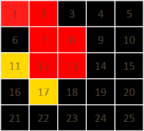
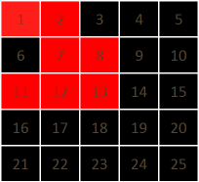
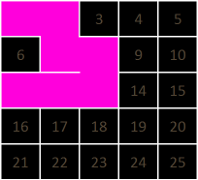
There are two possible next locations: #11 and #17.
STACK: 1 2 7 8 13 12
13
Wall between cells 1 2and 11
Is broken
14
We've selected #11.
This location is now pushed onto the stack.
We carve a path between #12 and #11.
STACK: 1 2 7 8 13 12 11

Slide 18
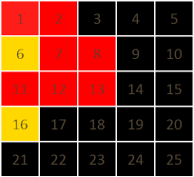
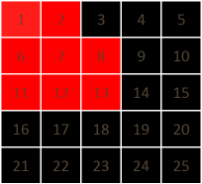
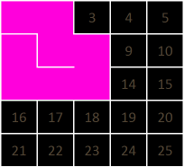
15
There are two possible next locations: #6 and #16.
STACK: 1 2 7 8 13 12 11
Wall between cells 11 and 6
Is broken
16
We've selected #6.
This location is now pushed onto the stack.
We carve a path between #11 and #6.
STACK: 1 2 7 8 13 12 11 6

Slide 19
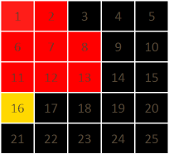
17
OK, here we have a problem. We're at a dead end.
There are no unvisted locations to go from #6.
This is where we back track, we pop off the last visited location off the stack.
Where were we before last before we go to this location? That's right, we were at #11.
STACK: 1 2 7 8 13 12 11 6
18
We return to #11.
Are there any, yet, unvisted neighbours for #11?
Well yes, there is one, and this is #16, so we'll go there.
This new location is added to the stack.
STACK: 1 2 7 8 13 12 11 16

Slide 20
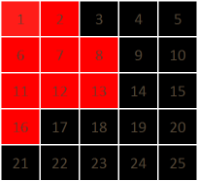
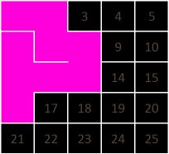
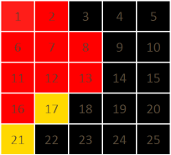
And we continue to carve the maze.
STACK: 1 2 7 8 13 12 11 16
19
Wall between cells 11 and 16 is broken
20
There are two possible locations from here: #17 and #21.
STACK: 1 2 7 8 13 12 11 16

Slide 21
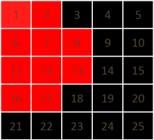
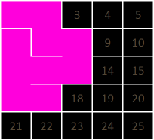
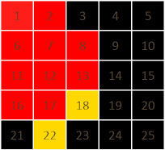
#17 is chosen.
STACK: 1 2 7 8 13 12 11 16 17
21
22
Wall between cells 11 and 17 Is broken
There are two possible locations from here: #18 and #22.
STACK: 1 2 7 8 13 12 11 16 17

Slide 22
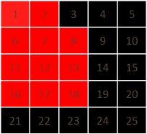
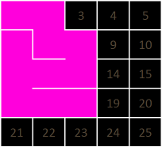
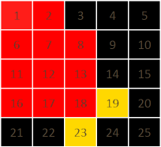
#18 is chosen.
STACK: 1 2 7 8 13 12 11 16 17 18
23
24
Wall between cells 17 and 18 Is broken
There are two possible locations from here: #19 and #23.
STACK: 1 2 7 8 13 12 11 16 17 18

Slide 23
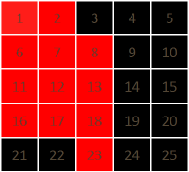
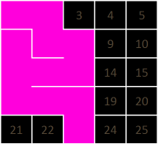
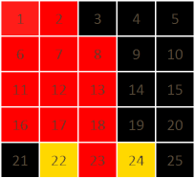
25
#23 is chosen.
STACK: 1 2 7 8 13 12 11 16 17 18 23
Wall between cells 18 and 23
Is broken
26
There are two possible locations from here: #22 and #24.
STACK: 1 2 7 8 13 12 11 16 17 18 23

Slide 24
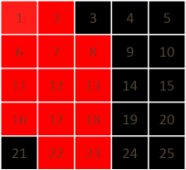
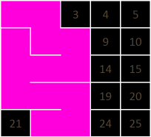
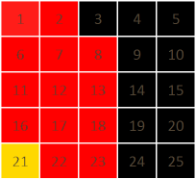
27
#22 is chosen.
STACK: 1 2 7 8 13 12 11 16 17 18 23 22
Wall between cells 23 and 22 is broken
28
There is only one possible location to go: #21.
STACK: 1 2 7 8 13 12 11 16 17 18 23 22

Slide 25
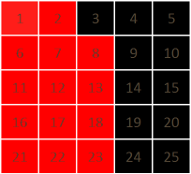
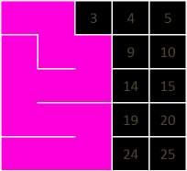
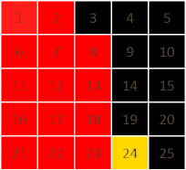
29
#21 is added.
STACK: 1 2 7 8 13 12 11 16 17 18 23 22 21
Wall between cells 22 and 21 Is broken
30
Again we've nowhere to go, so we pop off #21 from the stack.
This does not help us either, so we pop off the next value, #22.
We're back to #23.
There is only one possible location to go from here, and this is #24, so that's where we are heading next.
STACK: 1 2 7 8 13 12 11 16 17 18 23 22 21

Slide 26
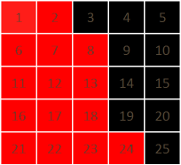
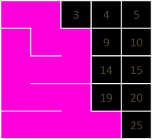
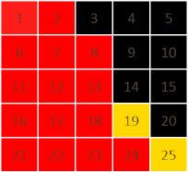
31
#24 is added.
STACK: 1 2 7 8 13 12 11 16 17 18 23 24
Wall between cells 23 and 24 Is broken
32
We carry on this process.
If you look closely, the stack, as it grows describes the solution to the maze. In fact, whilst we're using backtrack recursion to generate this maze, this same technique can actually be used to solve mazes.
STACK: 1 2 7 8 13 12 11 16 17 18 23 24

Slide 27
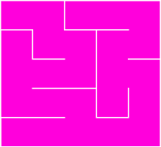
33
The stack will continue to increase and decrease in size as cells are added to the completed maze. Eventually, all the locations in the maze will be visited, and cells will be continuously popped off the stack as we confirm this. When the stack has reached zero length, we will be back where we started and every cell will have been visited. A stack length of zero is the termination criterion for this algorithm.
All finished!
STACK: (empty)

Slide 28

Maze Generation in Matlab
By Cleve moler
amaze.m
amazing.m
Cleve Barry Moler is an American mathematician and computer programmer specializing in numerical analysis. In the mid to late 1970s, he was one of the authors of LINPACK and EISPACK, Fortran libraries for numerical computing. He invented MATLAB, a numerical computing package, to give his students at the University of New Mexico easy access to these libraries without writing Fortran. In 1984, he co-founded MathWorks with Jack Little to commercialize this program

Slide 29
To understand his code
we need to know:
Graph Object in Matlab

Slide 30
Creating Grid and Plotting it

Slide 31
graph objects represent undirected graphs, which have direction-less edges connecting the nodes. After you create a graph object, you can learn more about the graph by using object functions to perform queries against the object. For example, you can add or remove nodes or edges, determine the shortest path between two nodes, or locate a specific node or edge.
G = graph([1 1], [2 3]);
e = G.Edges
G = addedge(G,2,3)
G = addnode(G,4)
plot(G)
Create and Modify Graph Object
Create a graph object with three nodes and two edges. One edge is between node 1 and node 2, and the other edge is between node 1 and node 3.

Slide 32
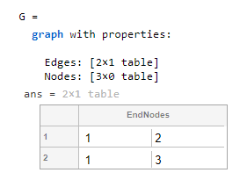
G = graph([1 1], [2 3]);
e = G.Edges
Once each node is
given name, dim
Changes to 3x1
1
2
3

Slide 33
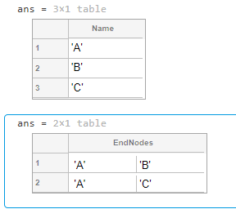
Add node names to the graph, and then view the new node and edge tables. The end nodes of each edge are now expressed using their node names.
G.Nodes.Name = {'A' 'B' 'C'}';
G.Nodes
e = G.Edges

Slide 34
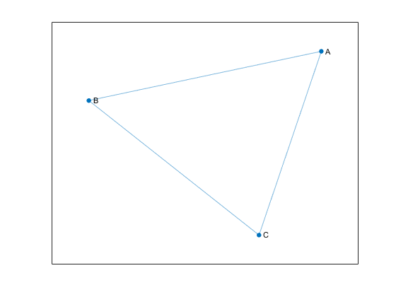
You can add or modify extra variables in the Nodes and Edges tables to describe attributes of the graph nodes or edges. However, you cannot directly change the number of nodes or edges in the graph by modifying these tables. Instead, use the addedge, rmedge, addnode, or rmnode functions to modify the number of nodes or edges in a graph.For example, add an edge to the graph between nodes 2 and 3 and view the new edge list.
G = addedge(G,2,3)
G = addnode(G,4)
plot(G)

Slide 35
Matlab has built in grid generator for
Finite Difference method for
Solving differential equation over a
a rectangular domain
Cleve Moler used it as a short cut

Slide 36
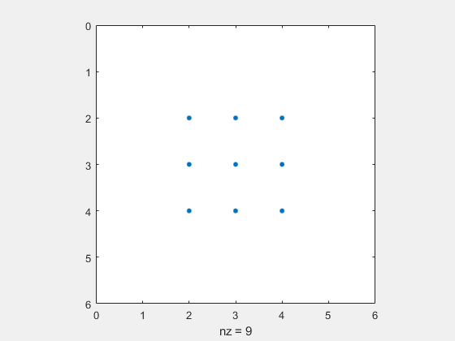

Square Grid
n = 3;
A=numgrid('S',n+2);
spy(A)
Db = delsq(A);
%full(Db)
B = graph(logical(Db),'omitselfloops');
figure
plot(B)
n = 3;
A=numgrid('S',n+2);
Db = delsq(A);
B = graph(logical(Db),'omitselfloops');
Do not worry what happens here.
Blindly use it to get a graph object
corresponding to a rectangular grid

Slide 37
Square Grid
n = 3;
A=numgrid('S',n+2);
Db = delsq(A);
B = graph(logical(Db),'omitselfloops’)
plot(B)
1 2
1 4
2 3
2 5
3 6
4 5
4 7
5 6
5 8
6 9
7 8
8 9
B=
Default plot orientation of
Graph object
Number of cells =4
Finite difference grid in Matlab

Slide 38
Plotting the graph object
To plot the way we want, give (x,y)
Coordinates of all the nodes in order
It already has edge information
Graph Object
X-coordinates of nodes in order
Y-coordinates of nodes in order
Bp = plot(B,'XData’, xcord, 'YData’, ycord, 'linewidth',lw, 'markersize',ms, 'nodelabel',{});
(nodes are numbered in column major order)

Slide 39


Easiest way of plotting a grid in Matlab
Two graph Objects
n = 4;
Db = delsq(numgrid('S',n+2));
B = graph(logical(Db),'omitselfloops');
% Cells, initially just nodes, no edges.
m = n-1; % m^2 cells
Dc = delsq(numgrid('S',m+2));
C = graph(logical(Dc),'omitselfloops');
dg = [0 .5 0];
Ccolor = dg
linestyle = '-';
lw = 3; % line width
ms = 4; $ marker size
k = (0:n^2-1)’; % rectangular grid points ordered from 0 to
Bp = plot(B,'XData',floor(k/n), 'YData',mod(n-k-1,n), 'linewidth',lw, 'markersize',ms, 'nodelabel',{});
axis equal ; set(gca,'xtick',[],'ytick',[])
hold on
k = 1:m^2;
Cp = plot(C,'XData',floor((k-1)/m)+0.5, 'YData',mod(n-k-1,m)+0.5, 'NodeLabel',{}, 'NodeColor',Ccolor, ...
'LineStyle',linestyle, 'EdgeColor','white', 'linewidth',3);
hold off
drawnow
(0,3)
3
2
1
0
1
5
9
13
1
4
7
2
6
10
14
C
B
2
8
5
3
7
11
15
12
3
6
9
4
8
16
0 1 2 3
C is point grid
(give (x,y) coordinates of nodes in graph in order)
See the ordering of the nodes if you create grid using numgrid

Slide 40

n = 10;
R = 'S';
G = numgrid(R,n);
spy(G)

Slide 41
Crux of the algorithm
B
n=4
1. A grid B of nxn nodes that defines nxn cells
2. A grid C of mxm nodes that defines mxm centres
of grid B. So, the size of grid C is ( n-1)x(n-1);
that is m=n-1
3. A function to compute which walls to open in grid B
as nodes in C are traversed based on the algorithm
m=3
C

Slide 42



B
C
Remove
Move from 1 to 4 in C
edge (5,6) in B
Move from 4 to 5 in C
edge (6,10) in B
Move from 5 to 8 in C
edge (10,11) in B
B
C
Which wall to break in terms of node numbers in B

Slide 43

wall
function [i,j] = wall(p,q,m)
% Wall [i,j] blocks path [p,q].
n=m+1;
switch q-p
case -m % west
i = p+ceil(p/m)-1;
j = i+1;
case -1 % north
i = p+ceil(p/m)-1;
j = i+n;
case 1 % south
i = p+ceil(p/m);
j = i+n;
case m % east
i = p+ceil(p/m)-1+n;
j = i+1;
end
end
Move from 1 to 4 in C
edge (5,6) in B
p=1, q=4, m=3,n=4
q-p=4-1=3=m
i=p+ceil(p/m)-1+n=1+ceil(1/3)-1+4=1+1-1+4=5
J=i+1=5+1=6
Move from 4 to 5 in C
edge (6,10) in B
p=4, q=5, m=3,n=4
q-p=5-4=1
i=p+ceil(p/m)=4+ceil(4/3)=4+2=6
J=i+n=6+4=10

Slide 44

We use an array to keep track of visited nodes
available = 1:m^2; % m^2 nodes in an m by m grid
P=1; % assume node 1 is visited. Then
available(p)=0
For m=3
 | 1 | 2 | 3 | 4 | 5 | 6 | 7 | 8 | 9
Array ‘available’
0 | 0 | 2 | 3 | 4 | 5 | 6 | 7 | 8 | 9
We use builtin ‘neighbors’ function that operate on a graph
m = 3; % m^2 cells
Dc = delsq(numgrid('S',m+2));
C = graph(logical(Dc),'omitselfloops’);
p=5;
ngh=neighbors(C,p)
Create a 3x3 point grid
ngh = 2 4 6 8

Slide 45
n = 4;
Db = delsq(numgrid('S',n+2));
B = graph(logical(Db),'omitselfloops');
% Cells, initially just nodes, no edges.
m = n-1; % m^2 cells
Dc = delsq(numgrid('S',m+2));
C = graph(logical(Dc),'omitselfloops');
available = 1:m^2; % Nodes we haven't visited yet.
branches = [];
tree = zeros(0,2); % Depth first search.
p = 1;
available(p) = 0;
[~,~,ngh] = find(available(neighbors(C,p)));
C
ngh
p=1
1
4
2
 | 1 | 2 | 3 | 4 | 5 | 6 | 7 | 8 | 9
0 | 0 | 2 | 3 | 4 | 5 | 6 | 7 | 8 | 9
Output
C = graph with properties:
Edges: [12×1 table]
Nodes: [9×0 table]
ngh = 2 4

Slide 46
n = 4;
Db = delsq(numgrid('S',n+2));
B = graph(logical(Db),'omitselfloops');
% Cells, initially just nodes, no edges.
m = n-1; % m^2 cells
Dc = delsq(numgrid('S',m+2));
C = graph(logical(Dc),'omitselfloops');
available = 1:m^2; % Nodes we haven't visited yet.
branches = [];
tree = zeros(0,2); % Depth first search.
p = 5;
available(p) = 0;
[~,~,ngh] = find(available(neighbors(C,p)));
C
ngh
p=5
4
2
5
8
6
p=5
 | 1 | 2 | 3 | 4 | 5 | 6 | 7 | 8 | 9
0 | 1 | 2 | 3 | 4 | 0 | 6 | 7 | 8 | 9
Output
C = graph with properties:
Edges: [12×1 table]
Nodes: [9×0 table]
tree wil be finally 2 column array of size m^2x2 .
Every time algorithm visit a new node , it will store
previous node and currently visited node numbers
as a pair.
ngh = 2 4 6 8

Slide 47
How array ‘available’ is utilized
0 | 1 | 2 | 3 | 4 | 0 | 6 | 7 | 8 | 9
Every time algorithm visit a new node say k, available(k) is assigned as zero.
This will enable us to decide two things.
Has algorithm visited all node?.
Using neighbour function on graph and the array ‘available’ , we can do back tracking
(back tracking is done whenever we reach a node whose all neighbours are already visited)

Slide 48
Array ‘tree’
tree =
1 4
4 5
5 2
2 3
3 6
6 9
9 8
8 7
Contiguous
1
7
4
Array ‘tree keep track of the trajectory of
the visited nodes.
It need not be contiguous
2
5
8
3
6
9
tree =
1 4
4 5
5 6
6 3
3 2
6 9
9 8
8 7
1
Non-Contiguous

Slide 49
How backtracking is taken care of
Whenever a new node p in graph C is visited , we will find number of unvisited neighbors for it by the following nested commands
[~,~,ngh] = find(available(neighbors(C,p)));
If number of un-visited neighbors of node p are more than 1, we note this information in an array ‘branches’ by appending the node number p in it.
if length(ngh) > 1
% Could have chosen another neighbor.
branches(end+1) = p;
end
One of the Matlab way of appending
Whenever we reach a new node p for which unvisited nodes are empty, we look up for a branching node in the array ‘branches’

Slide 50
Removing elements in branches
for p = branches
if all(available(neighbors(C,p)) == 0)
branches(branches==p) = [];
end
end

Slide 51

Breaking the walls of graph B
Whenever a new node in Graph C is visited , we need to
find edges in Graph B that should be removed.
% Add a cell and remove a barrier.
tree(end+1,:) = [p q];
[i,j] = wall(p,q,m);
B = rmedge(B,i,j);
‘rmedge’ is a built in command that operate on a graph object

Slide 52
Now go through the two codes
amaze.m
And
amazing.m

Slide 53
For those who dare to fly
to the dizzy heights

Slide 54
Different Maze Generating
algorithms

Slide 55
Many are variants of Graph
algorithms
Aldous-Broder
Backtracking Generator
Binary Tree
Cellular Automaton
Dungeon Rooms
Eller's
Growing Tree
Hunt-and-Kill
Kruskal's
Prim's
Recursive Division
Sidewinder
Wilson's

Slide 56
Spanning Tree
The progress of recursive backtracker.

Slide 57
Spanning Tree
Prim's algorithm

Slide 58
Spanning Tree
Prim's algorithm

Slide 59
Spanning Tree
The progress of Prims algorithm

Slide 60
Spanning Tree
The progress of Kruskal's algorithm.

Slide 61
Spanning Tree
The progress of Kruskal's algorithm.

Slide 62
Spanning Tree
Binary Tree algorithm

Slide 63
Spanning Tree
Binary Tree algorithm

Slide 64
Spanning Tree
Sidewinder algorithm

Slide 65
Spanning Tree
Sidewinder algorithm

Slide 66
Spanning Tree
Hunt-and-Kill algorithm.

Slide 67
Spanning Tree
Hunt-and-Kill algorithm.

Slide 68
Spanning Tree
Growing tree algorithm

Slide 69
Spanning Tree
Growing tree algorithm

Slide 70
Spanning Tree
Eller's algorithm.

Slide 71
Spanning Tree
Aldous-Broder algorithm

Slide 72
Spanning Tree
Aldous-Broder algorithm

Slide 73
Spanning Tree
The progress of Wilson's algorithm.

Slide 74
Spanning Tree
The progress of Wilson's algorithm.

Slide 75
Spanning Tree
The progress of Wilson's algorithm.

Slide 76
Minimum Spanning Tree

Slide 77
Minimum Spanning Tree

Slide 78
Minimum Spanning Tree

Slide 79

Aldous-Broder
1

Slide 80

https://raw.githubusercontent.com/theJollySin/mazelib/master/docs/images/backtracking_7x7.gif
Backtracking Generator
2

Slide 81

3
Binary Tree
https://raw.githubusercontent.com/theJollySin/mazelib/master/docs/images/binary_tree_7x7.gif

Slide 82

4
Cellular Automaton
https://raw.githubusercontent.com/theJollySin/mazelib/master/docs/images/cell_auto_7x7.gif

Slide 83

https://raw.githubusercontent.com/theJollySin/mazelib/master/docs/images/dungeon_rooms_11x11.gif
Dungeon Rooms
5

Slide 84

https://raw.githubusercontent.com/theJollySin/mazelib/master/docs/images/ellers_7x7.gif
Eller's
6

Slide 85

https://raw.githubusercontent.com/theJollySin/mazelib/master/docs/images/growing_tree_7x7.gif
7
Growing Tree

Slide 86

https://raw.githubusercontent.com/theJollySin/mazelib/master/docs/images/huntandkill_7x7.gif
8
Hunt-and-Kill

Slide 87

https://raw.githubusercontent.com/theJollySin/mazelib/master/docs/images/kruskal_7x7.gif
Kruskal's
9

Slide 88
https://raw.githubusercontent.com/theJollySin/mazelib/master/docs/images/prims_7x7.gif
Prim's
10

Slide 89


Recursive Division
https://raw.githubusercontent.com/theJollySin/mazelib/master/docs/images/division_7x7.gif
11

Slide 90

https://raw.githubusercontent.com/theJollySin/mazelib/master/docs/images/sidewinder_7x7.gif
Sidewinder
12

Slide 91

Wilson’s
13
https://raw.githubusercontent.com/theJollySin/mazelib/master/docs/images/wilsons_7x7.gif

Slide 92

https://github.com/theJollySin/mazelib/blob/master/docs/MAZE_TRANSMUTE_ALGOS.md
https://github.com/theJollySin/mazelib/blob/master/docs/MAZE_SOLVE_ALGOS.md

Slide 93

https://scipython.com/blog/maze-generation-by-cellular-automaton/

Slide 94
https://medium.com/analytics-vidhya/maze-generations-algorithms-and-visualizations-9f5e88a3ae37
https://hurna.io/academy/algorithms/maze_generator/binary.html
https://in.mathworks.com/help/nav/ref/mapmaze.html
http://militzer.berkeley.edu/EPS109/final_projects_2013/

Slide 95
Matlab Built in function
Introduced in R2021a
mapMaze
Generate random 2-D maze
Syntax
map = mapMaze
map = mapMaze(passageWidth)
map = mapMaze(passageWidth, wallThickness)
map = mapMaze(___, Name,Value)

Slide 96

% Generate a random 2-D maze map with a passage width of 5 grid cells and wall thickness of 2 %grid cells. Specify the size of the map as 50 meters wide and 30 meters high with a resolution %of 5 cells per meter.
map = mapMaze(5,2,'MapSize',[50 30],'MapResolution',5);
%Visualize the generated obstacle map.
show(map)

Slide 97
Reference sites
https://datagenetics.com/blog/november22015/index.html
https://github.com/theJollySin/mazelib/blob/master/docs/MAZE_GEN_ALGOS.md
https://raw.githubusercontent.com/theJollySin/mazelib/master/docs/images/aldous_broder_7x7.gif
https://scipython.com/blog/maze-generation-by-cellular-automaton/
Python code
https://github.com/theJollySin/mazelib

